Slide 1
Group Policy
Operating System Practical Lecture

Slide 2
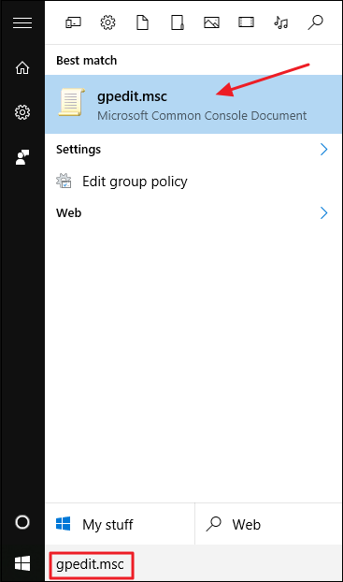
How to Always open All Control Panel Items when opening Control Panel
Go to Start button and type
gpedit.msc Or
Open Run and type gpedit.msc then
Click Ok

Slide 3
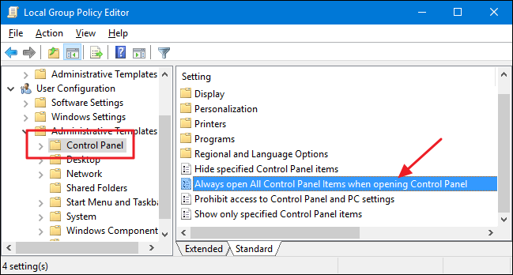
How to Always open All Control Panel Items when opening Control Panel
In the Local Group Policy Editor, go to User Configuration > Administrative Templates > Control Panel.
On the right, find the “Always open All Control Panel Items when opening Control Panel” and double-click it.

Slide 4
How to Always open All Control Panel Items when opening Control Panel
In the properties window that opens, you can configure things one of three ways:
Select the “Not Configured” option to allow the default behavior where Control Panel always opens to the last view you used.
Select the “Enabled” option to force Control Panel to open with the icon view.
Select the “Disabled” option to force Control Panel to open with the category view.
After you’ve made your selection, click “OK.”

Slide 5
How to Always open All Control Panel Items when opening Control Panel

Slide 6
How to disable Control Panel access
In the Local Group Policy Editor, go to User Configuration > Administrative Templates > Control Panel.
On the right, find the “Prohibit access to Control Panel and PC settings” and double-click it.
After you’ve made your selection, click “OK.”

Slide 7
How to Remove Properties from the Recycle Bin
In the Local Group Policy Editor, go to User Configuration > Administrative Templates > Desktop.
On the right, find the “Remove Properties from the Recycle Bin context menu” and double-click it.
After you’ve made your selection, click “OK.”

Slide 8
How to Prevent access to the Shutdown, Restart, Sleep and Hibernate commands
In the Local Group Policy Editor, go to User Configuration > Administrative Templates > Start Menu and Taskbar.
On the right, find the “Remove and prevent access to the Shut down, Restart, Sleep, and Hibernate commands” and double-click it.
After you’ve made your selection, click “OK.”

Slide 9
How to Disable Run
In the Local Group Policy Editor, go to User Configuration > Administrative Templates > Start Menu and Taskbar.
On the right, find the “Remove Run menu from Start Menu” and double-click it.
After you’ve made your selection, click “OK.”

Slide 10
How to Disable Right Click on the Taskbar
In the Local Group Policy Editor, go to User Configuration > Administrative Templates > Start Menu and Taskbar.
On the right, find the “Remove access to the context menus for the taskbar” and double-click it.
After you’ve made your selection, click “OK.”

Slide 11
How to Disable Command Prompt(CMD)
In the Local Group Policy Editor, go to User Configuration > Administrative Templates > System.
On the right, find the “Prevent access to the command prompt” and double-click it.
After you’ve made your selection, click “OK.”

Slide 12
How to Disable Registry Editor
In the Local Group Policy Editor, go to User Configuration > Administrative Templates > System.
On the right, find the “Prevent access to registry editing tools” and double-click it.
After you’ve made your selection, click “OK.”

Slide 13
How to Prevent access to the Task Manager
In the Local Group Policy Editor, go to User Configuration > Administrative Templates > System > Ctrl+Alt+Del options.
On the right, find the “Remove Task Manager” and double-click it.
After you’ve made your selection, click “OK.”

