Slide 1

Lecture - 7 - Navigation Architectures & Deep Linking
Technical College of Zakho
Computer Information Systems
Mobile Application Development I
Sipan M. Hameed
https://www.sipan.dev/

Slide 2
Lecture Agenda
Hour 1: Routing Concepts. Stack navigation, tabbed navigation, drawer architectures, and mobile "wayfinding."
Hour 2: Advanced Routing. Deep linking, Universal/App Links, and passing conceptual data between screens.

Slide 3
The Mobile Navigation Problem
The Web Paradigm: Browsers have a built-in address bar, a universal back button, and tabs. Navigation is native to the browser.
The Mobile Paradigm: A mobile app is a closed box. Developers must build the entire navigation infrastructure from scratch.
The Goal: "Wayfinding." The user must always know exactly where they are in the app, how they got there, and how to get back.

Slide 4
Information Architecture (IA)
The Concept: Before moving between screens, you must map out how the app's data is organized.
Flat Architecture: All primary categories are accessible from the main screen (best for tools like Instagram or Spotify).
Deep Architecture: Users must click through multiple layers of menus to find what they need (best for complex utilities like Settings or banking apps).

Slide 5
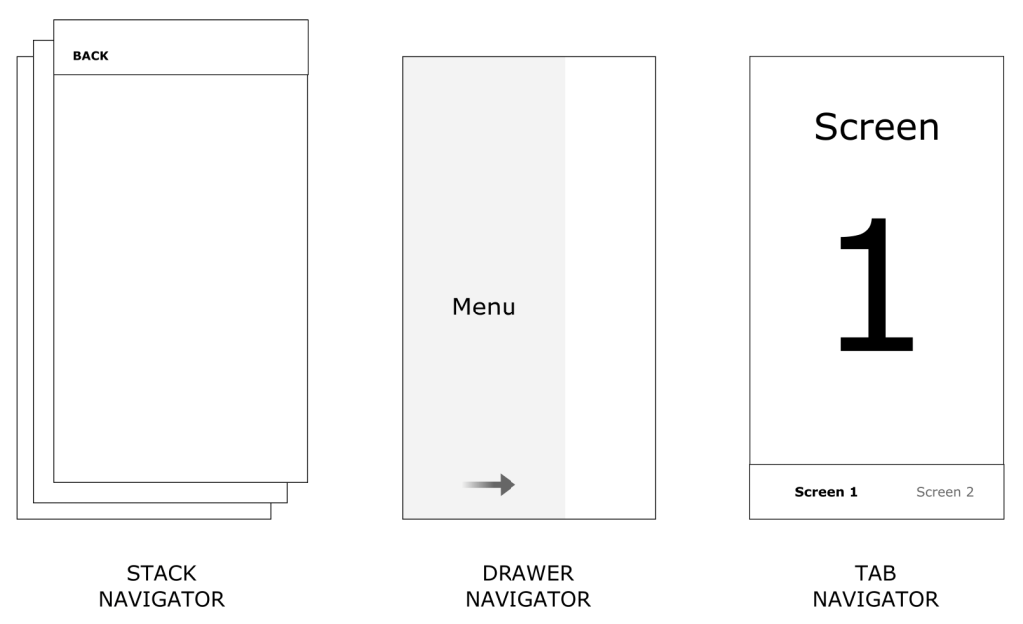

Slide 6
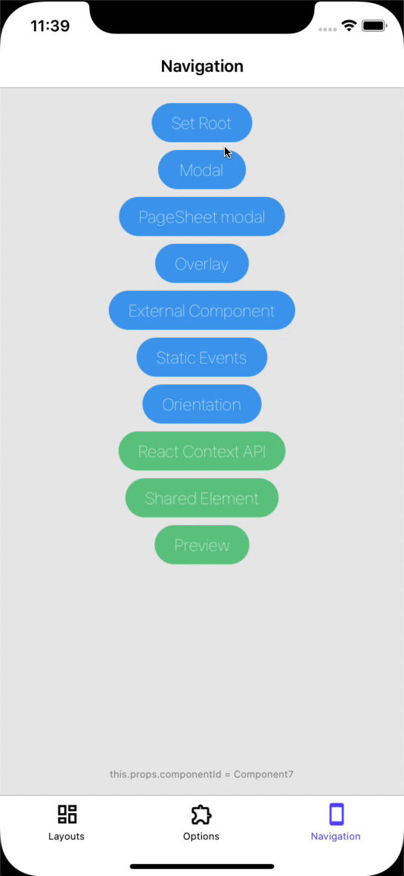
Architecture 4: Modal Navigation

Slide 7
Architecture 1: Stack Navigation
The Data Structure: Built entirely on the LIFO (Last-In, First-Out) Stack data structure.
The Action (Push): When a user taps an item, a new screen is "pushed" onto the top of the stack, covering the previous screen.
The Action (Pop): When a user hits the "Back" button, the top screen is "popped" off and destroyed, revealing the screen underneath.

Slide 8
Visualizing the Stack
Lecturer Note: Use a physical metaphor here (like stacking playing cards or cafeteria trays).
The State: The screens underneath the top card are in the "Inactive" or "Suspended" state (referencing Week 4). They are not dead, just hidden.
Root Node: The bottom-most card is the root. It cannot be popped without exiting the app.

Slide 9
Architecture 2: Tabbed Navigation
The Concept: A flat navigation model allowing rapid switching between the core, top-level destinations of an app.
Placement: iOS firmly establishes this at the bottom (Human Interface Guidelines). Android historically used top tabs but has mostly transitioned to bottom tabs for ergonomics (the Thumb Zone).
The Rule of Tabs: Switching tabs should not push a new screen onto a stack; it swaps the root view entirely.

Slide 10
The Complexity of Nesting (Stacks inside Tabs)
The Scenario: A user goes to the "Search" tab, clicks a profile (pushes to stack), clicks a photo (pushes to stack). Then they click the "Home" tab. What happens when they click "Search" again?
The Architectural Choice: * Do you preserve the stack within that specific tab? (Usually yes).
  Do you clear the stack if they tap the active tab icon a second time? (Standard behavior on iOS/Android).

Slide 11
Architecture 3: The Navigation Drawer
The Concept: The "Hamburger Menu" (three horizontal lines). An off-canvas menu that slides in from the left side of the screen.
Use Case: Perfect for housing secondary or tertiary features that do not deserve a spot on the main bottom tab bar (e.g., Settings, Help, About Us).

Slide 12
The Hamburger Menu Controversy
The UX Problem: "Out of sight, out of mind." Features hidden in a drawer see drastically lower engagement than those on a tab bar.
Reachability: On large modern phones, the top-left corner is the absolute hardest place for a right-handed user to reach.
The Trend: Many modern apps are abandoning the drawer entirely in favor of a "Profile" or "Menu" tab on the bottom bar.

Slide 13
Architecture 4: Modal Navigation
The Concept: A screen that slides up from the bottom and covers part or all of the screen, interrupting the current flow.
The Difference: Unlike a Stack (which implies moving deeper into a flow), a Modal implies a temporary detour (e.g., "Create a New Post" or "Select a Date").
Dismissal: Usually dismissed by swiping down or tapping an "X", rather than a traditional back button.

Slide 14
Route Management Systems
String-Based Routing: Similar to web URLs. You tell the app: Navigator.goTo('/profile/settings').
Object/Component-Based Routing: You tell the app to explicitly render a specific class: Navigator.push(ProfileScreen()).
The Evolution: Modern declarative frameworks heavily favor string-based or path-based routing because it makes Deep Linking much easier.

Slide 15
Passing Data Between Routes
The Challenge: How does the DetailsScreen know which item was tapped on the ListScreen?
The Solution (Payloads/Arguments): When executing a push command, developers pass a "payload" (like a product ID or a JSON object) to the new route's constructor.
Best Practice: Pass only lightweight IDs rather than massive data objects, letting the new screen fetch its own heavy data.

Slide 16
Summary & Break
Recap: Navigation is Wayfinding. Stacks move you deeper (LIFO), Tabs move you laterally, Drawers hide secondary items, Modals interrupt.
10-Minute Break before Hour 2.

Slide 17
Hour 2: Advanced Routing & Deep Linking
Welcome Back: The Walls of the App
In Hour 1, we learned how users navigate inside the closed box of the app.
In Hour 2, we explore how to break the walls of that box. How do we get a user from an email, an SMS, or a web search directly to a specific screen deep inside our app?

Slide 18
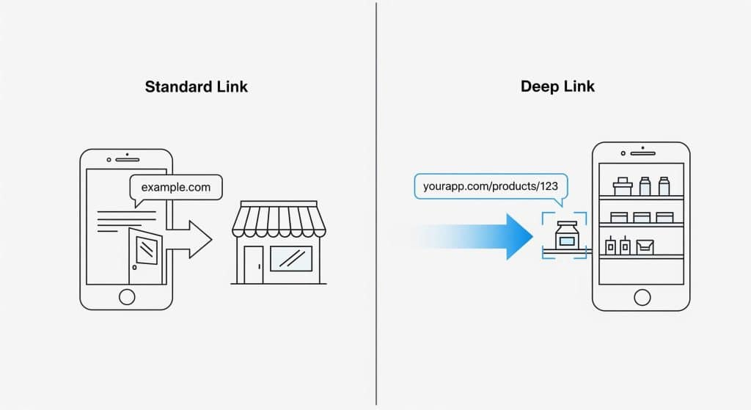

Slide 19
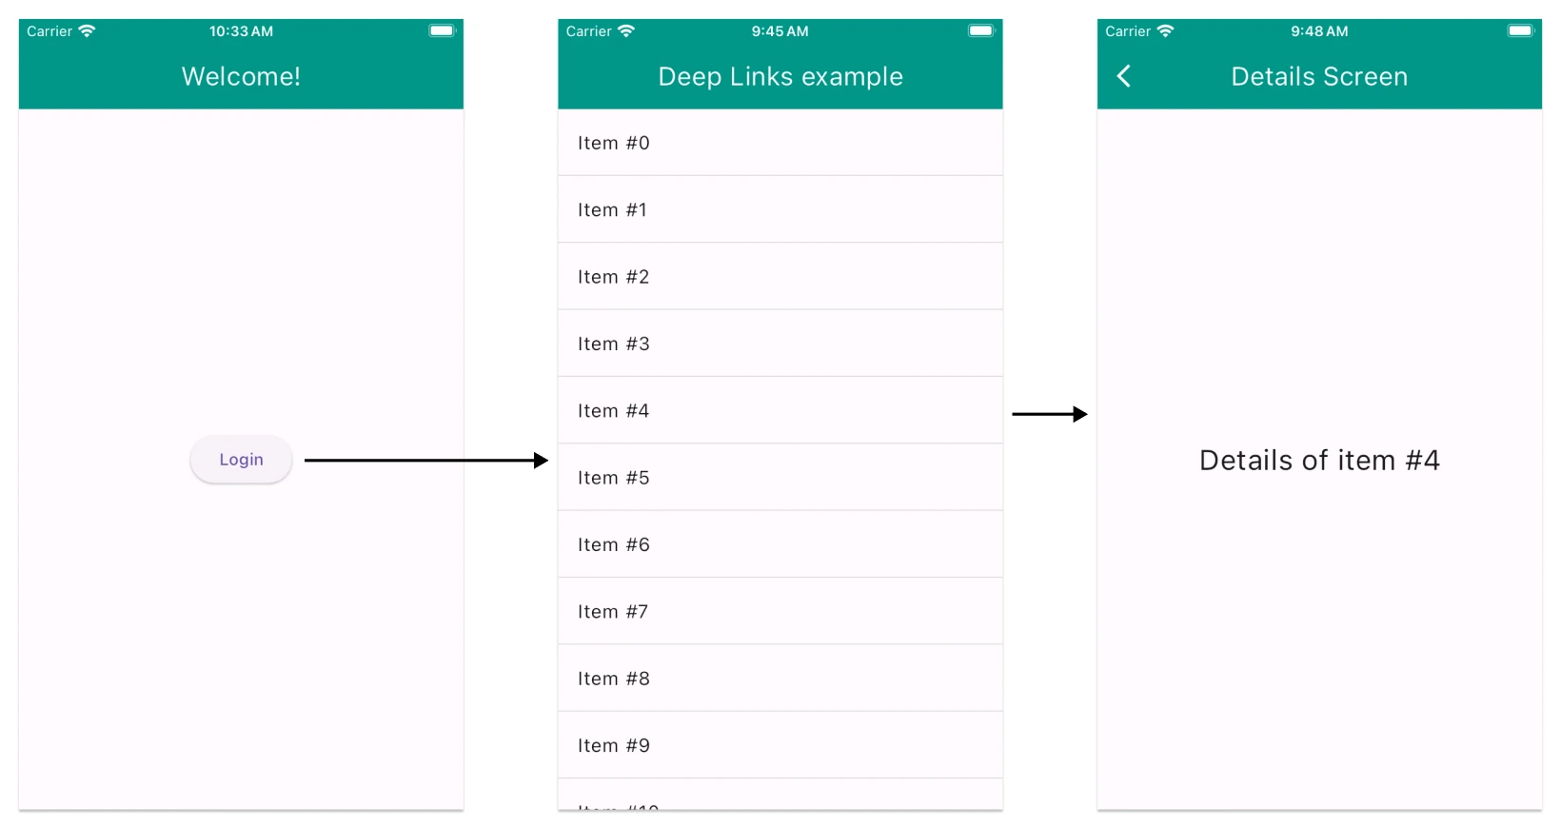

Slide 20
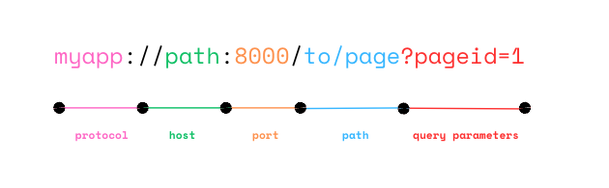
Deep Link Structure

Slide 21
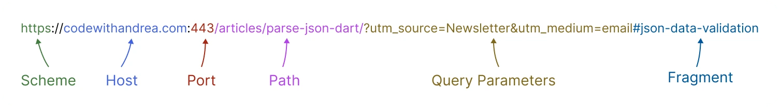
Anatomy of a Deep Link

Slide 22
What is a Deep Link?
Definition: A hyperlink that routes a user to a specific, deeply nested screen inside a mobile application, bypassing the app's home screen.
The Goal: Seamless user experience. If a friend texts you a link to a specific shoe on Nike.com, tapping it should open the Nike App directly to that shoe's screen, not the Nike App homepage.

Slide 23
Traditional Deep Linking (Custom URI Schemes)
How it worked historically: Developers registered a custom prefix with the operating system. Instead of http://, they used something like twitter:// or spotify://.
The Flow: Tapping spotify://track/123 tells the OS, "Find the app that claimed the 'spotify' name and pass it this URL."

Slide 24
The Flaws of Custom URI Schemes
The Name-Squatting Problem: Anyone could build a malicious app and claim the twitter:// scheme. If a user installed it, tapping a Twitter link might open the hacker's app instead.
The "Not Installed" Error: If the user did not have the app installed, tapping spotify:// would result in a broken link or an ugly OS error, because web browsers don't know what to do with that prefix.

Slide 25
The Modern Standard: Universal Links (iOS) & App Links (Android)
The Concept: Standardizing deep links using regular, standard web URLs (https://).
The Benefit: If the app is installed, the OS intercepts the https:// click and opens the app. If the app is not installed, the URL acts normally and falls back to opening the mobile website.

Slide 26
How Universal/App Links Work (Security First)
The Handshake: How does Apple/Google know you actually own that https:// domain?
The Process:
  The developer places a specific cryptographic JSON file on their website's server.
  The mobile app contains the matching cryptographic key.
  Upon installation, the OS verifies the app against the website's server. No spoofing is possible.

Slide 27
Deferred Deep Linking
The Scenario: A user clicks a link for 20% off a specific pair of shoes, but they don't have the app installed. The link takes them to the App Store.
The Magic: They download the app, open it for the very first time, and the app remembers the shoe they were looking for 5 minutes ago and routes them directly to it.
How it works: Relies on third-party tracking services (like AppsFlyer or Firebase Dynamic Links) that fingerprint the user's IP and device during the App Store transition.

Slide 28
Translating the Link to the UI Tree
The Engineering Task: When the OS hands the URL https://myapp.com/products/456 to your app, your routing system must parse that string.
The Execution: The app intercepts the string, extracts the variable (456), automatically builds a ProductScreen injected with ID 456, and pushes it onto the navigation stack.

Slide 29
Handling Back Navigation with Deep Links
The Problem: If a deep link drops a user directly onto screen 4 of your app, what happens when they press "Back"?
The Empty Stack: Because they bypassed the home screen, the navigation stack is empty. Pressing back might close the app entirely!
The Solution: "Synthetic Back Stacks." The developer must program the routing engine to artificially insert a "Home Screen" underneath the Deep Linked screen so the back button behaves logically.

Slide 30
Security Implications of Deep Linking
The Danger: A malicious website could trigger an App Link that executes a sensitive action inside your app (e.g., https://bank.com/transfer?amount=1000).
The Rule: Deep links should only be used for navigation and reading data. They should never be allowed to execute destructive or financial transactions automatically without secondary user confirmation.

Slide 31
Summary and Looking Ahead
Recap: Navigation structures define the app's skeleton. Deep links connect the external web to your internal routes securely.

Slide 32
?

